Slide 1
PID Balance Ball Team 34 組員 : 葉蓁 劉多聞

Slide 2
Outline
Motivation
Operating Principle
Design Flow
Part List
Mechanism Design
Demonstration
Discuss

Slide 3
Motivation
1

Slide 4
We want to integrate what we have learned
Logic Design Laboratory is the most important which can integrate all we learned this semester
Machine Design helps us design the mechanism
Control System (I) taught us PID control
Embedded System aided the project

Slide 5
Operating Principle
2

Slide 6
Mode 1 – Only FPGA
Control Servo Motor
Seven Segment displays duty cycle

Slide 7
Mode 1 – FPGA work
Use Switch SW[0:10] to select duty cycle
Duty cycle is fed to PWM module
Stop the motor when the ball is balanced
(Steady state error within certain percent.)

Slide 8
Mode 2 – FPGA and Arduino
FPGA’s work
(1 )Compute PID
(2)Control Servo Motor
(3)Get distance from Arduino
Arduino’s work
Only measure infrared sensor’s signal and send to FPGA

Slide 9
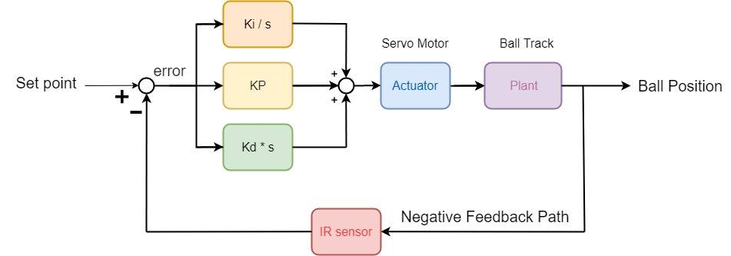
Mode 2 – PID Transfer Function
Block Diagram

Slide 10
Mode 2 – PID control
P control : To reduce error
the motor current is set in proportion to the existing error.
I control : Reduce steady-state error
An integral term to avoid stuck in wrong position. It relates to not only the error but also the time for which it has persisted.
D control : Reduce Overshoot
A derivative term, multiply the rate of change of error, trying to stop the ball.

Slide 11
Part List
3
-Mechanical
-Electrical

Slide 12
Mechanical Parts
M4 nut and screw
M3 nut and screw
M4 screw 150mm
Motor Stand
Shaft Support
L-shaped Angle Steel

Slide 13
Electrical Parts
FPGA
Arduino Mega
MG995 – Servo Motor
Infra Red distance sensor
Bread board
Jumpers

Slide 14
Engineering Drawing
4

Slide 15
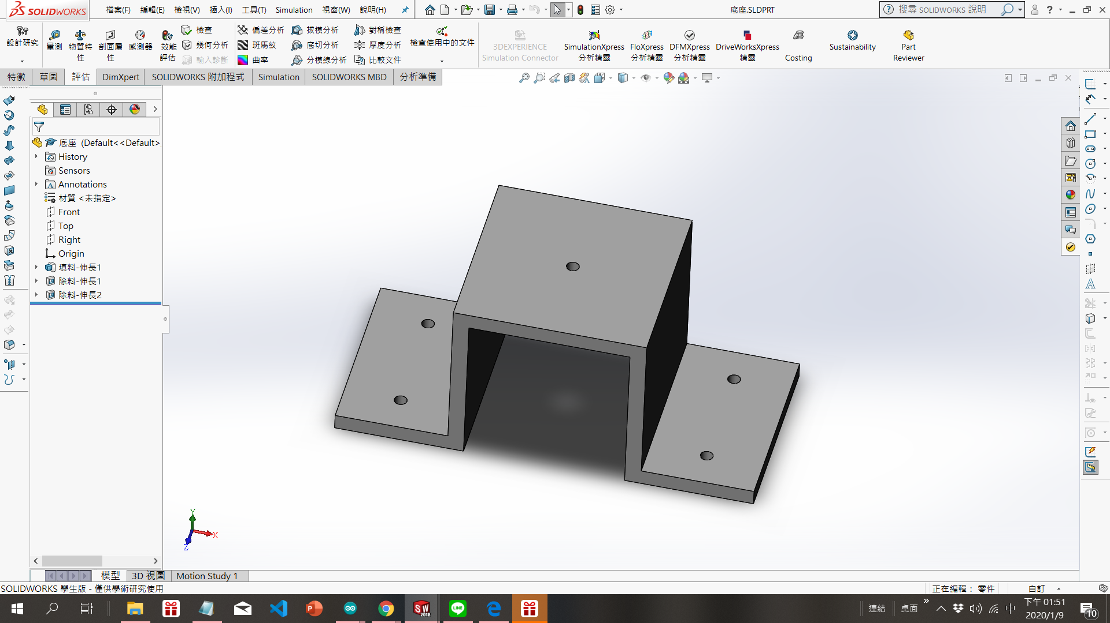
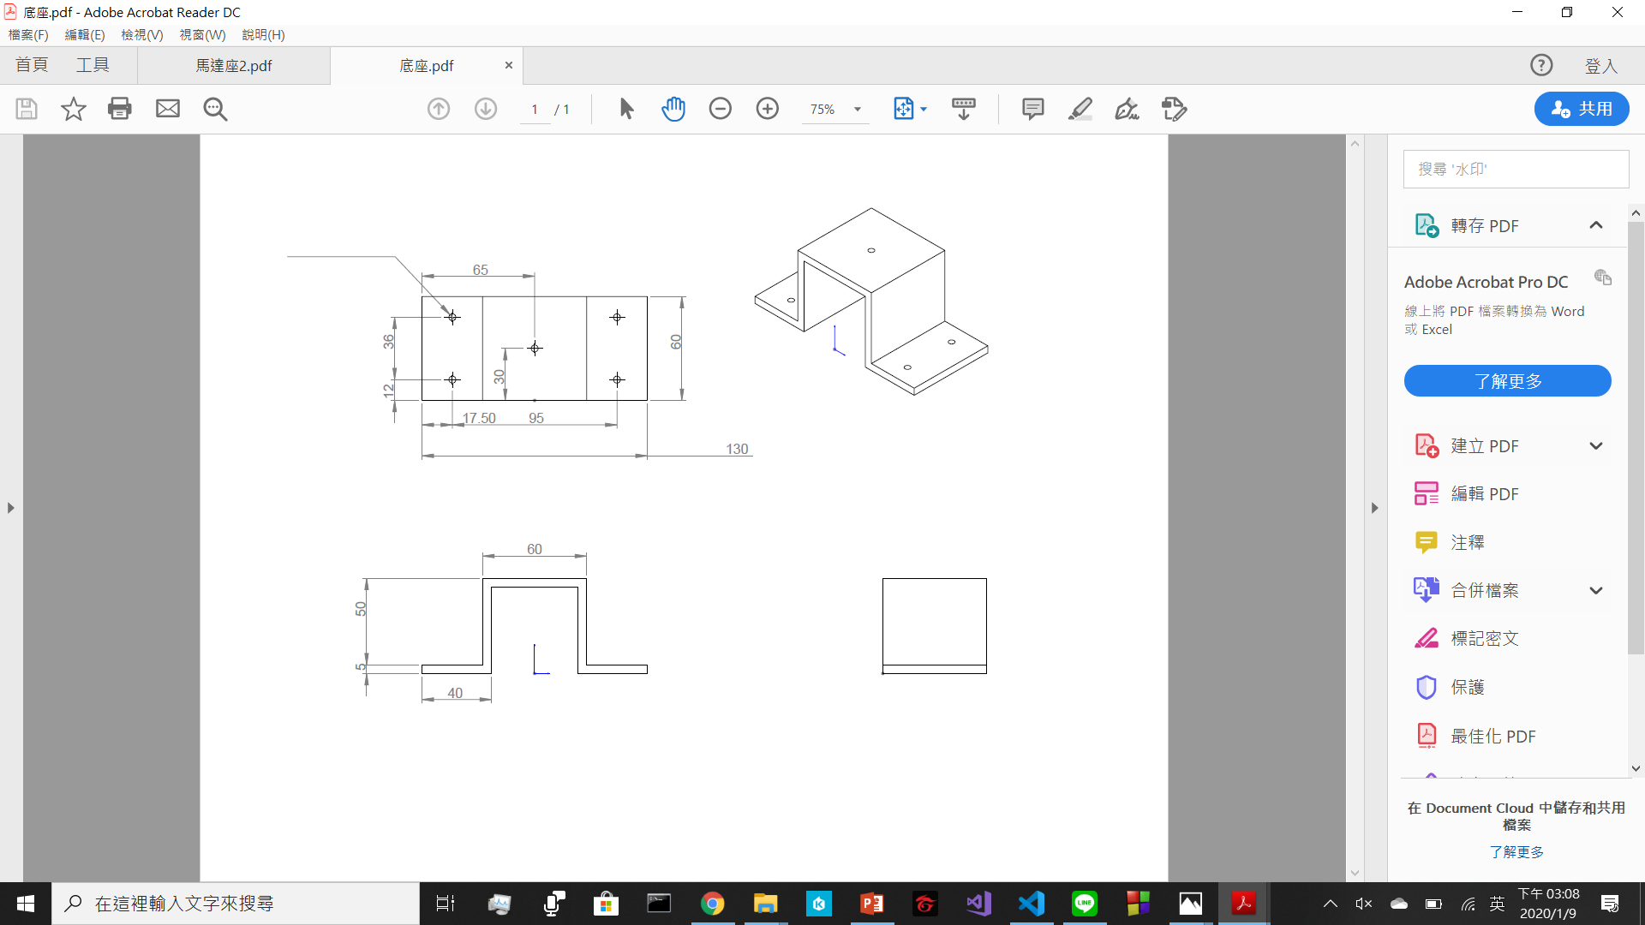
Engineering Drawing-Shaft Support

Slide 16
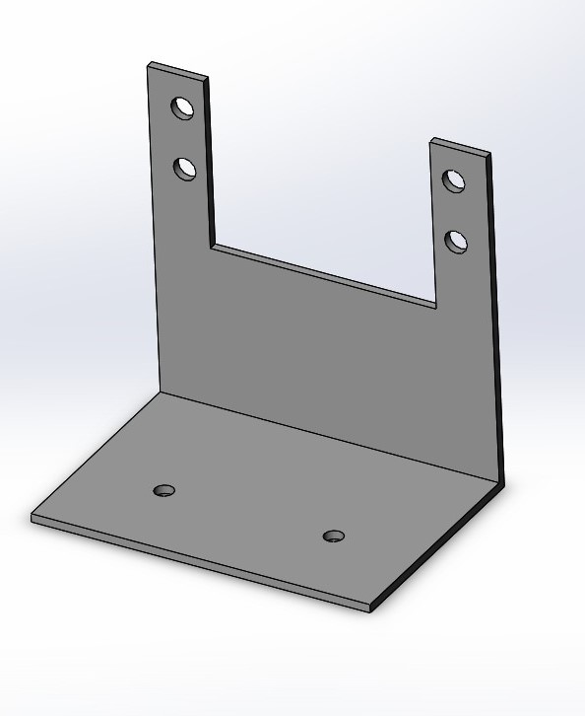
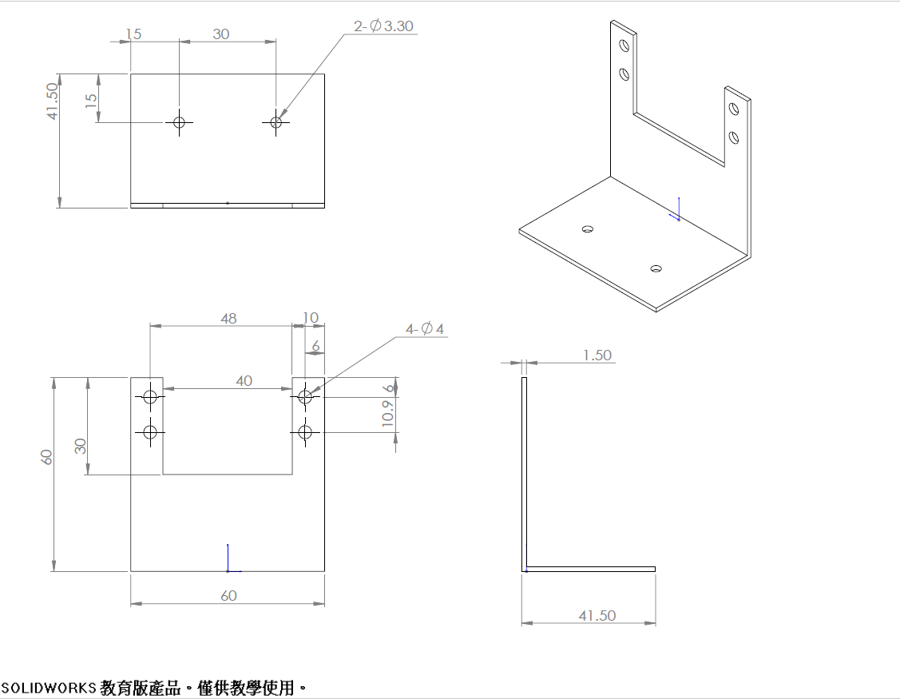
Engineering Drawing-Motor Housing

Slide 17
Mechanism Design
5
-Final assembly
-Beam
-Multi-Linkages

Slide 18
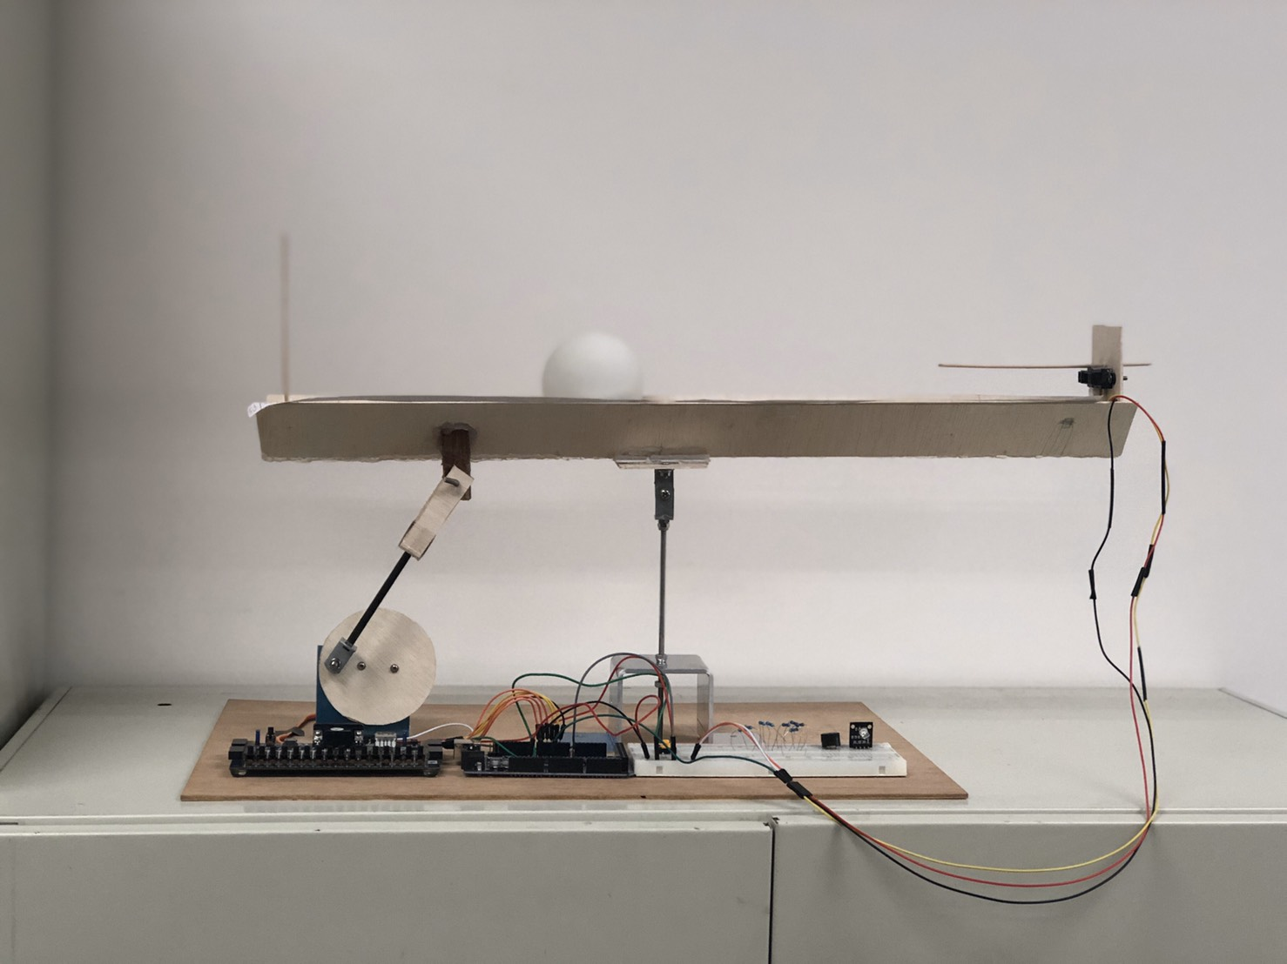
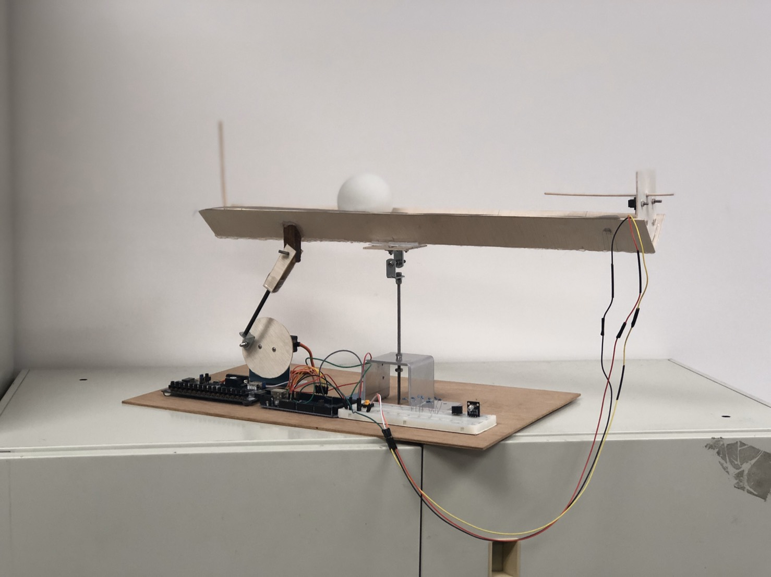
Final assembly

Slide 19
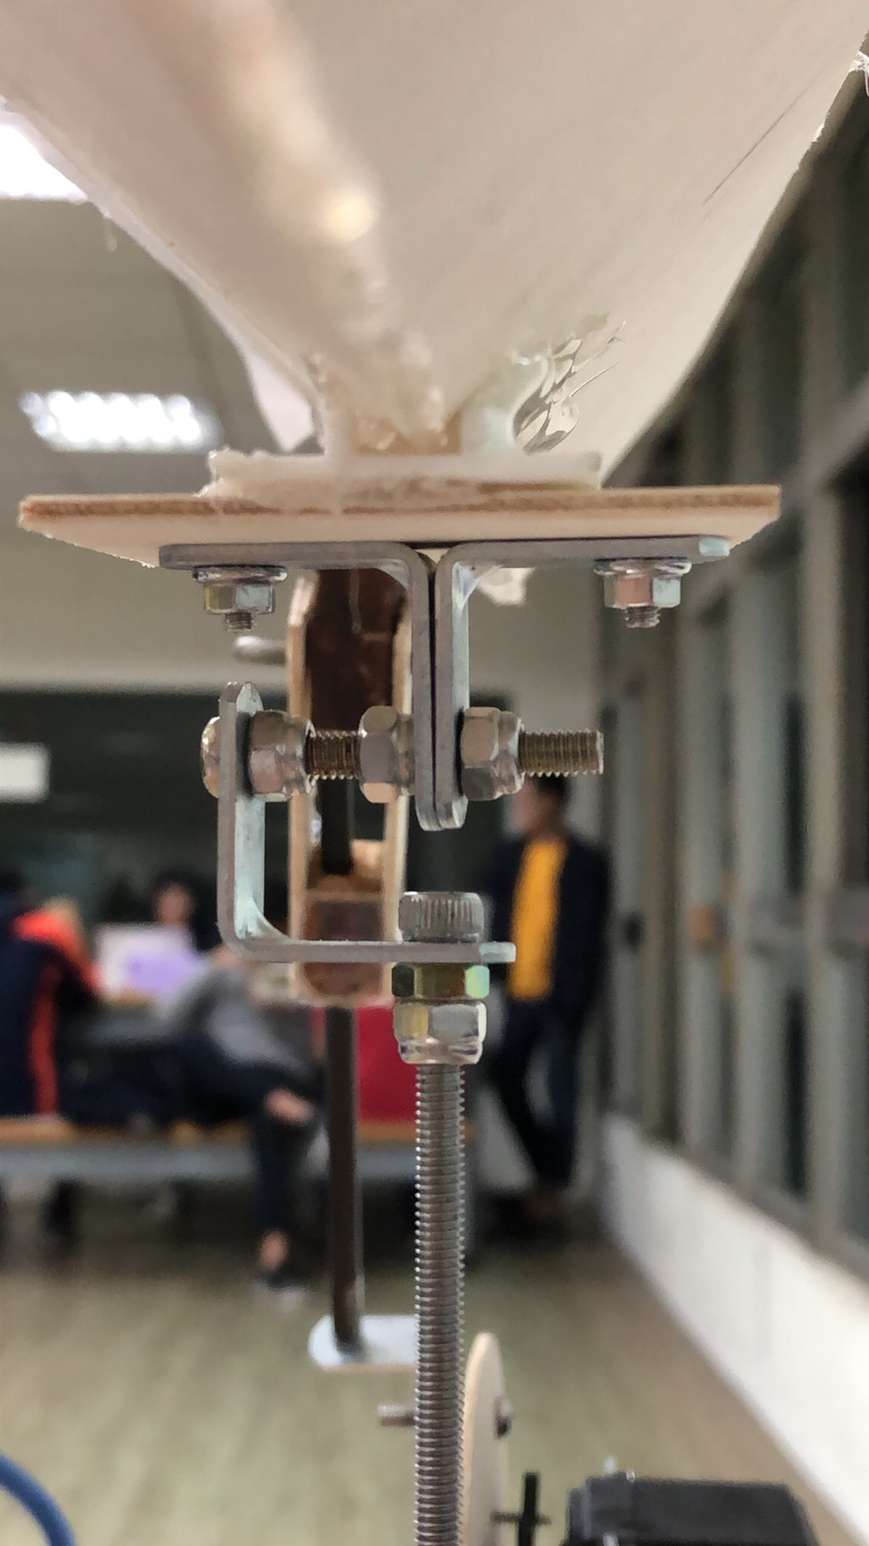
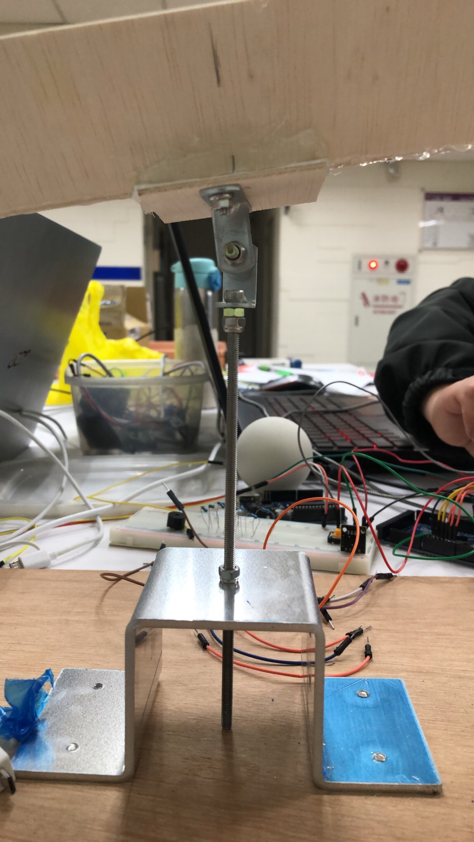
Balance Beam System

Slide 20
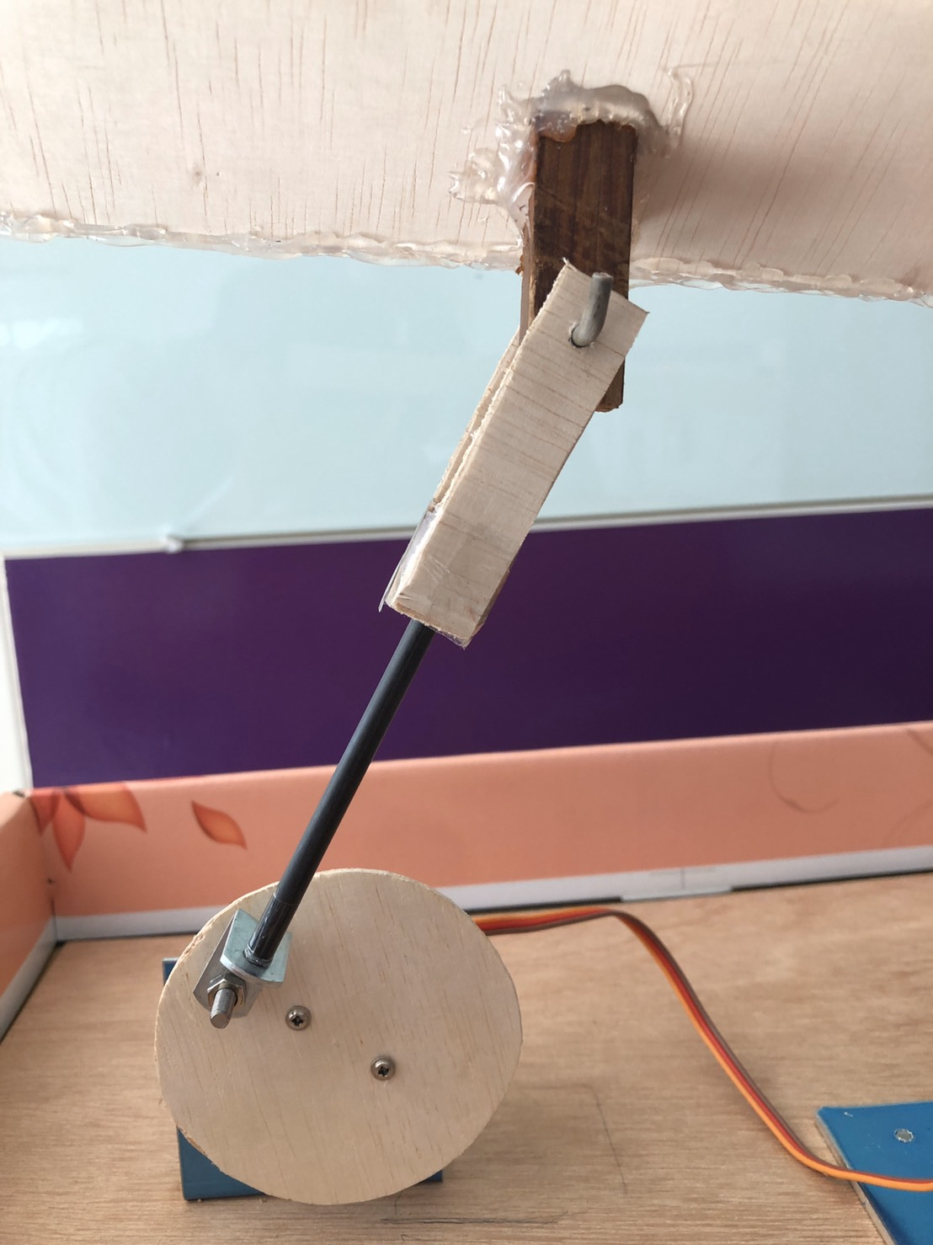
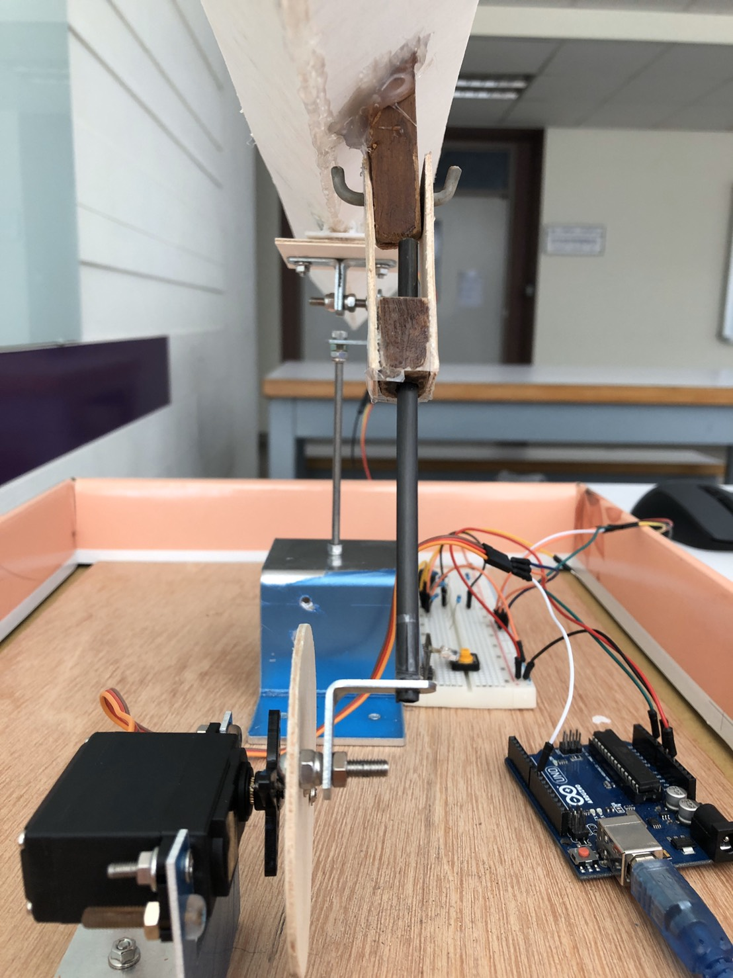
Multi-Linkage System

Slide 21
Design Flow
6

Slide 22
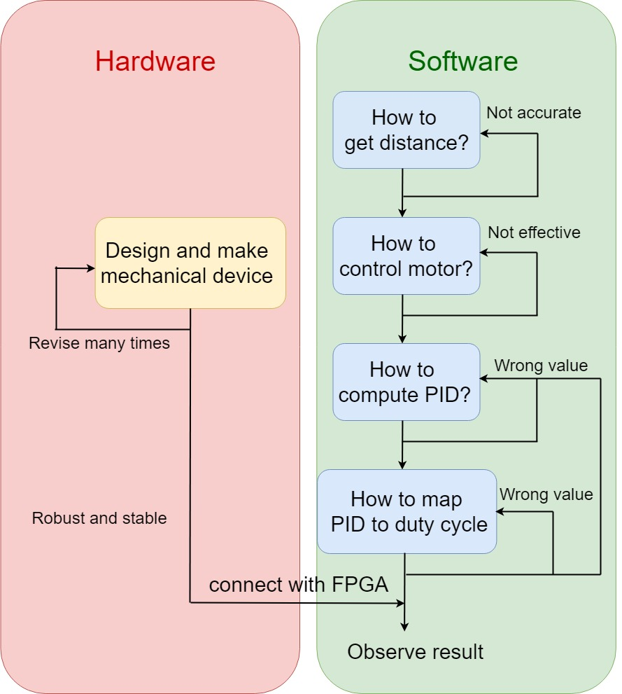
Design Flow
Notes:
流程圖

Slide 23
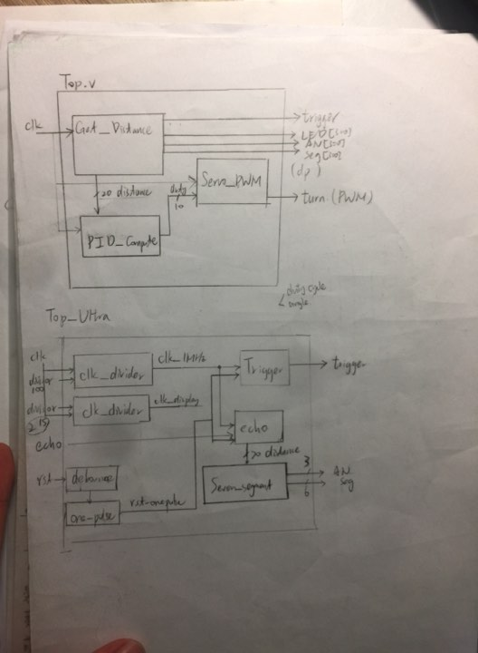
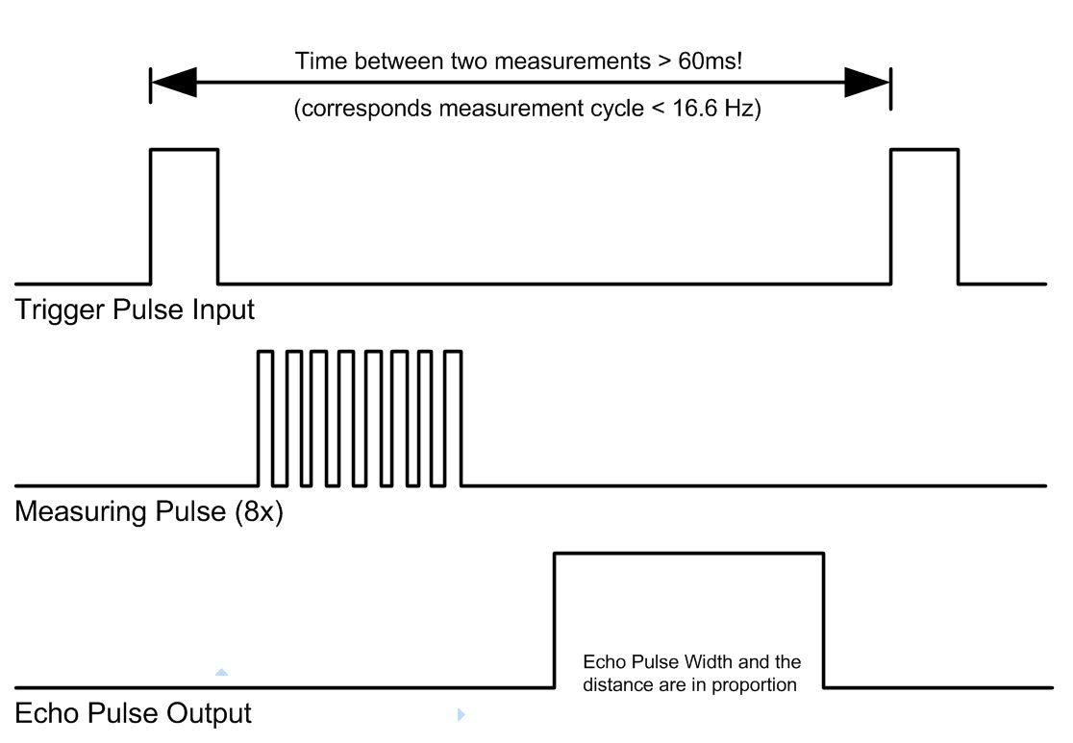
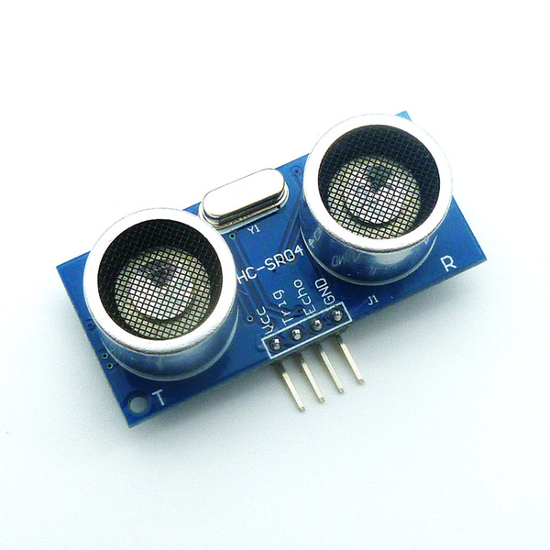
How to get distance?
Easy, but
Not accurate!

Slide 24
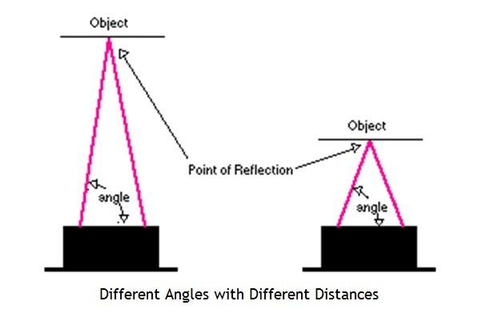
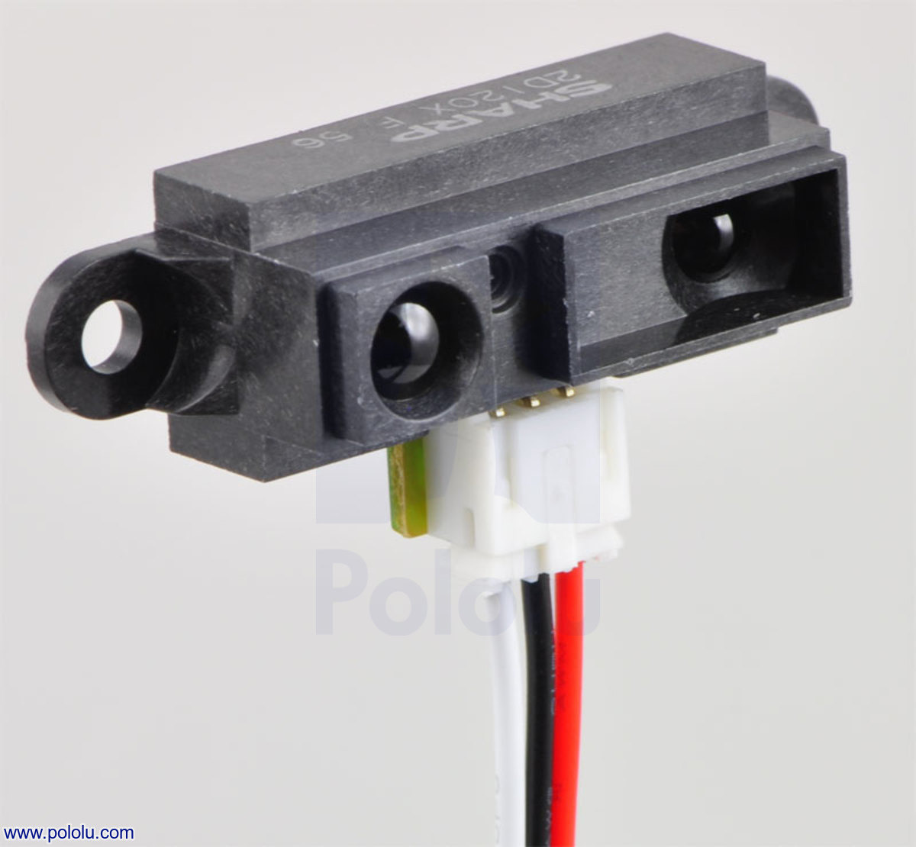
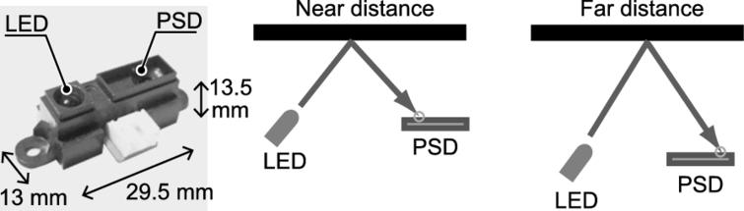
How to get distance?
Accurate!
Hard to implement using FPGA

Slide 25
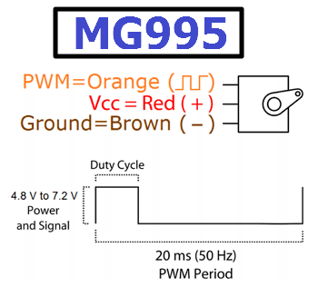
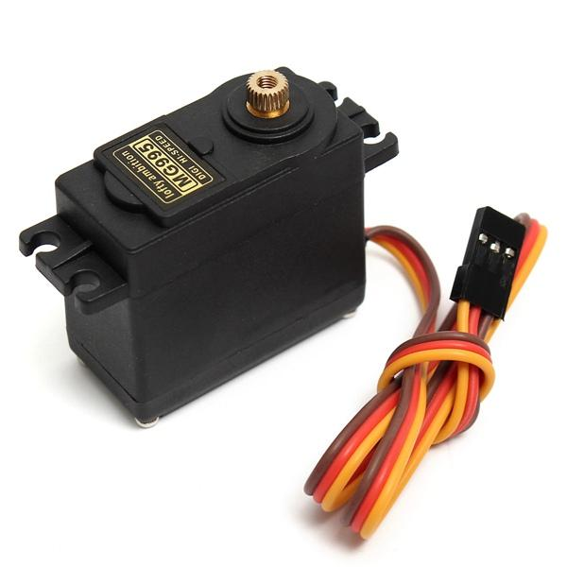
How to control servo motor?
Notes:
High torque13 kg-m/ 0-180degree

Slide 26
How to connect both?
Notes:
Block diagram

Slide 27
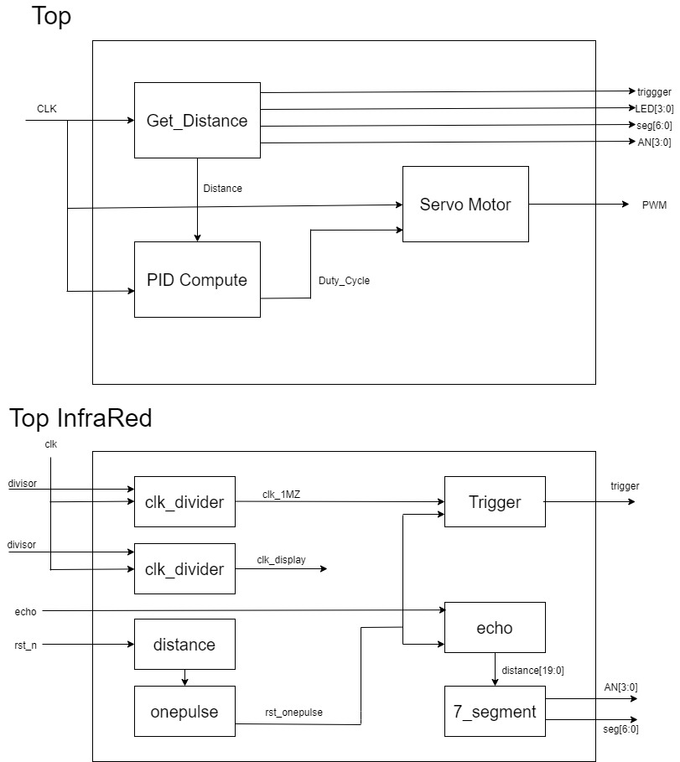
How to connect both?
Notes:
Block diagram

Slide 28
How to connect both?
Top Ultrasonic
Notes:
Block diagram

Slide 29
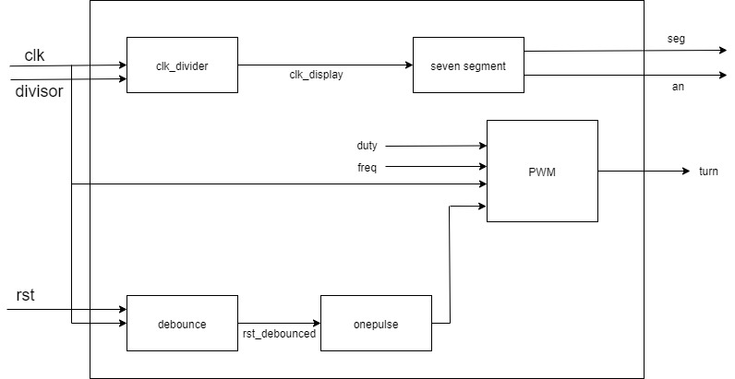
How to connect both?
Mode one Top Servo
Notes:
Block diagram

Slide 30
Demonstration
6

Slide 31
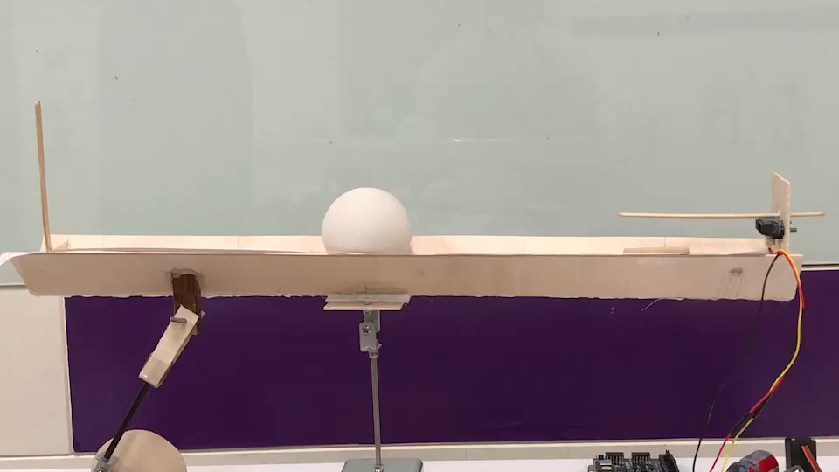
PID Control Video-1

Slide 32
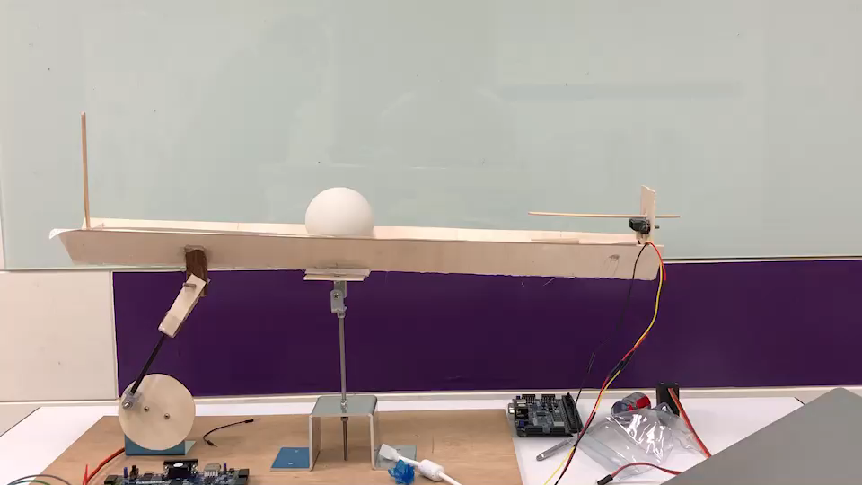
PID Control Video-2

Slide 33
Discuss
7

Slide 34
Discuss
Can we get distance from the infrared sensor using Verilog and FPGA?
Can we use better control method?
Can we extend the dimension more, e.g. 2D balance ball plate. The mechanism, sensor used, and algorithm would be far more complex.

Slide 35
THANKS!
Any questions?

